Slide 1
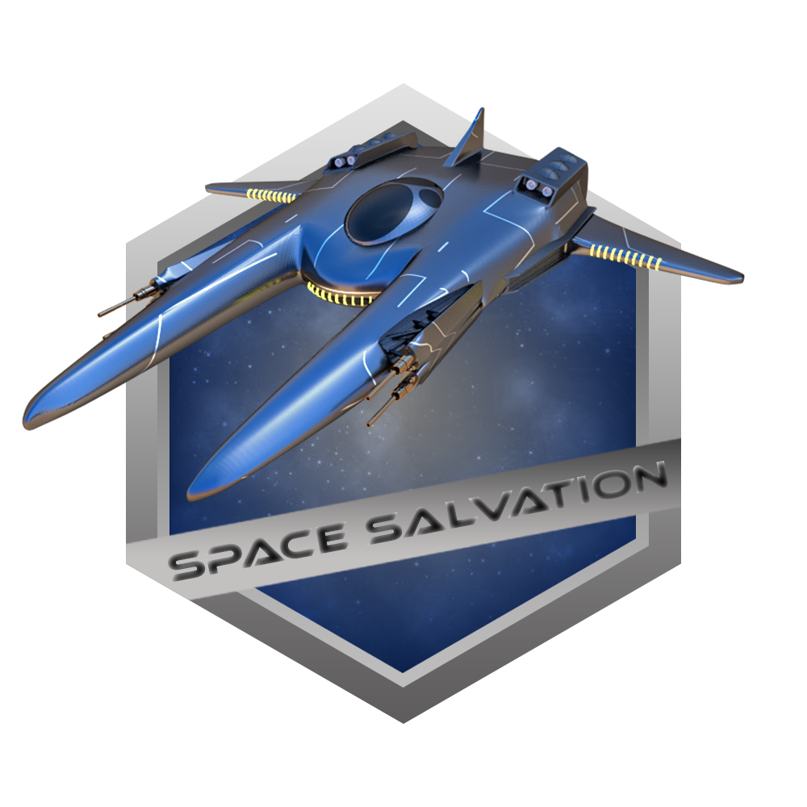
Space Salvation

Slide 2
Game Overview
Genre
Type
Number of levels

Slide 3
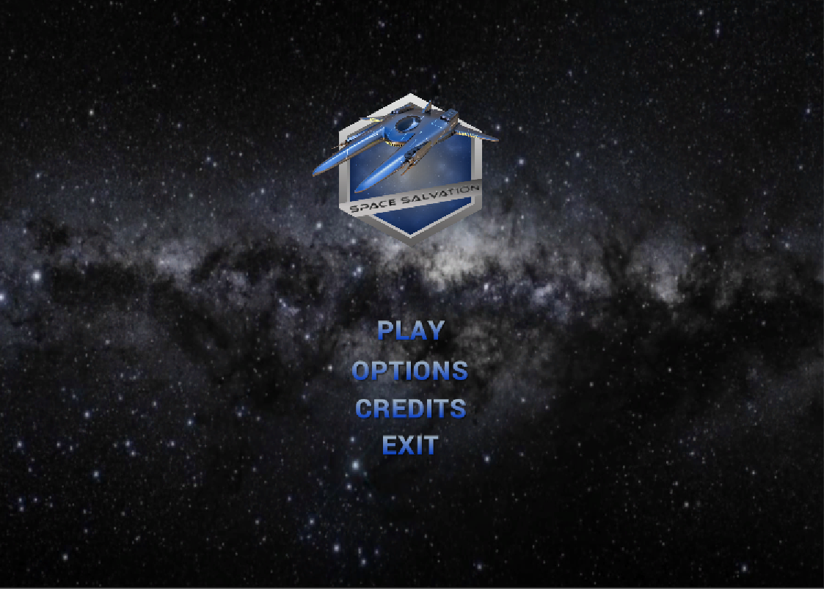
Start Menu

Slide 4
Controls
Movements
Ship movement
Speed boost
Shooting
Regular shooting
Nuclear shooting
Mouse navigation
Left shift
Mouse right click / Space
?? Button

Slide 5
Health, score, lives and death conditions
Health
Initial value 100%
Each hit decreases by 20%
Each Health kit adds 20%
Score
Each star adds 100 points
After 1000 points collected, 1 extra life granted
After each level completion + 200 points
Lives
Initial quantity 3
After each 10 stars collected + 1 life
Death
Once all lives lost
Once being hit with asteroid

Slide 6
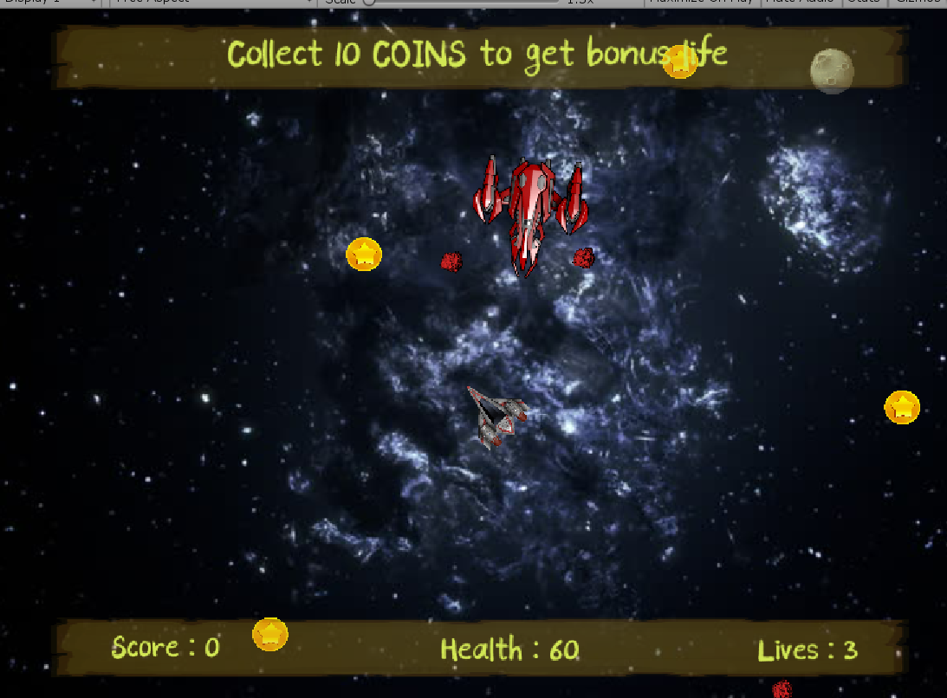
Level 1
Task:
Dodge the enemy’s bullets and shoot back
Each hit reduces Enemy’s health by ?? %
Collect coins to get extra points / life
Collect health kits; each adds 20%
Avoid asteroids collision!

Slide 7
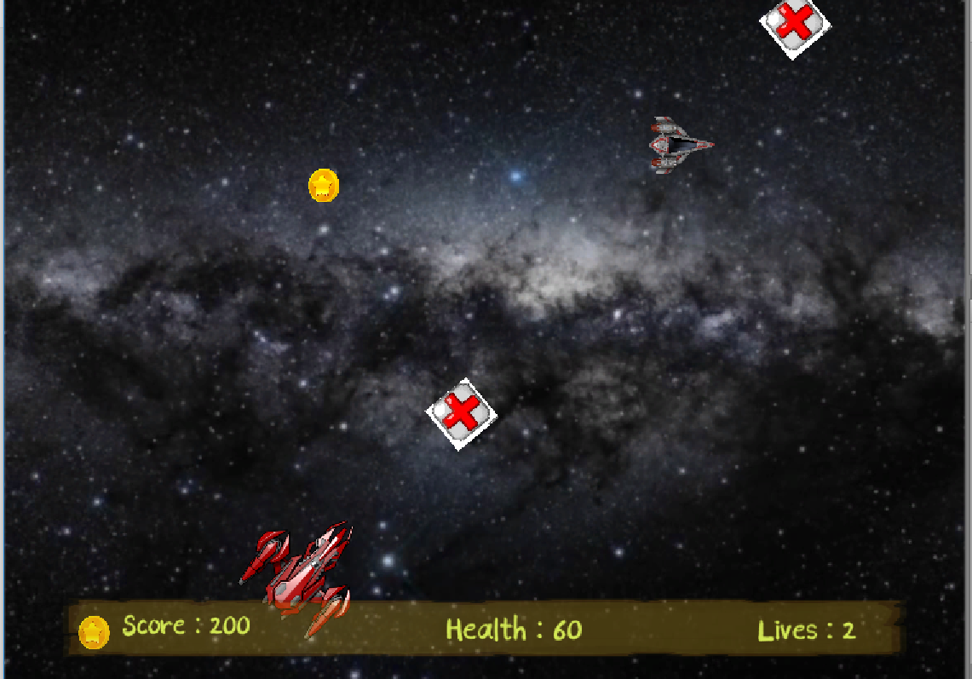
Level 2
Task:
Dodge the enemy’s bullets and shoot back
Each hit reduces Enemy’s health by ?? %
Collect coins to get extra points / life
Collect health kits; each adds 20%
After first enemy destroyed, expect second one!

Slide 8
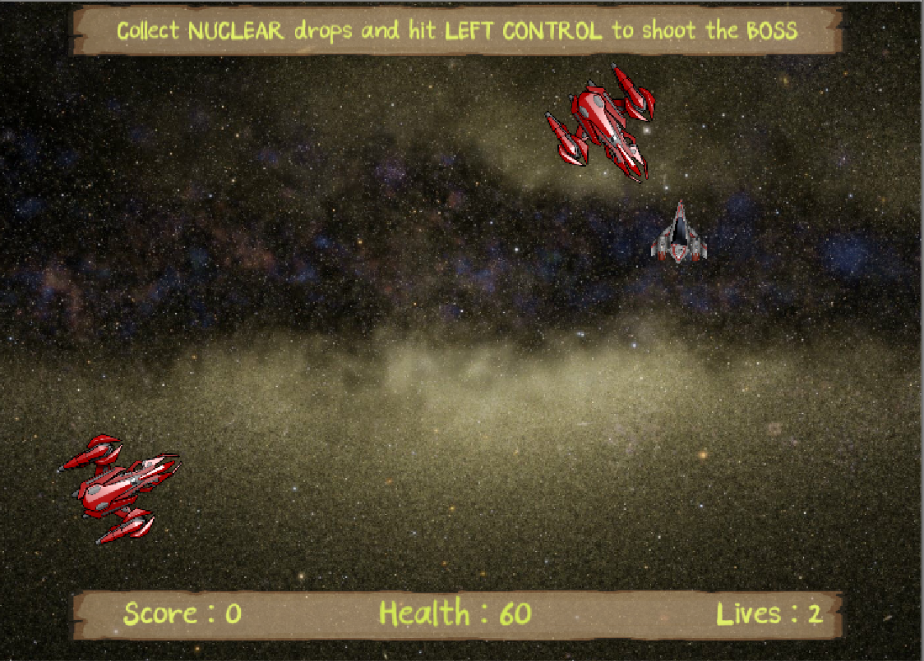
Level 3
Task:
Enemies shoot simultaneously!
Dodge the enemies’ bullets and shoot back
Each hit reduces Enemy’s health by ?? %. After destroy, collect nuclear drops they emitting

Slide 9
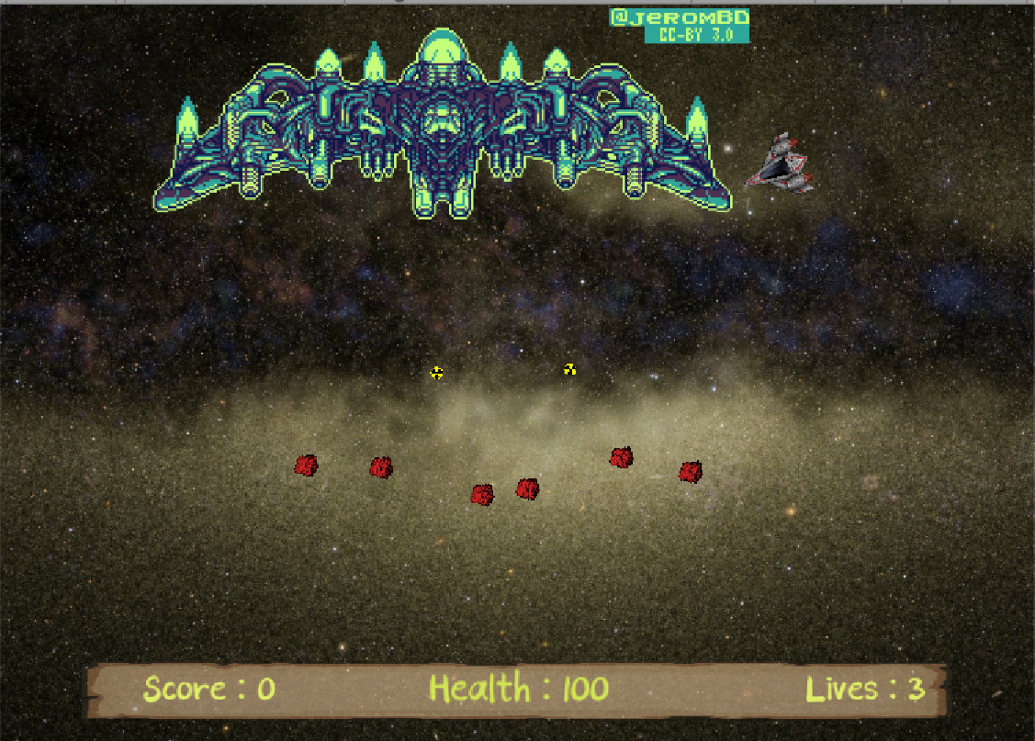
Level 3 (cont.)
Task:
After enemies destroyed, Boss comes to the scene
Use regular bullets to reduce Boss’s health by 5% and nuclear that take off 25%
Boss also drops nuclear bombs – collect them to shoot

Slide 10
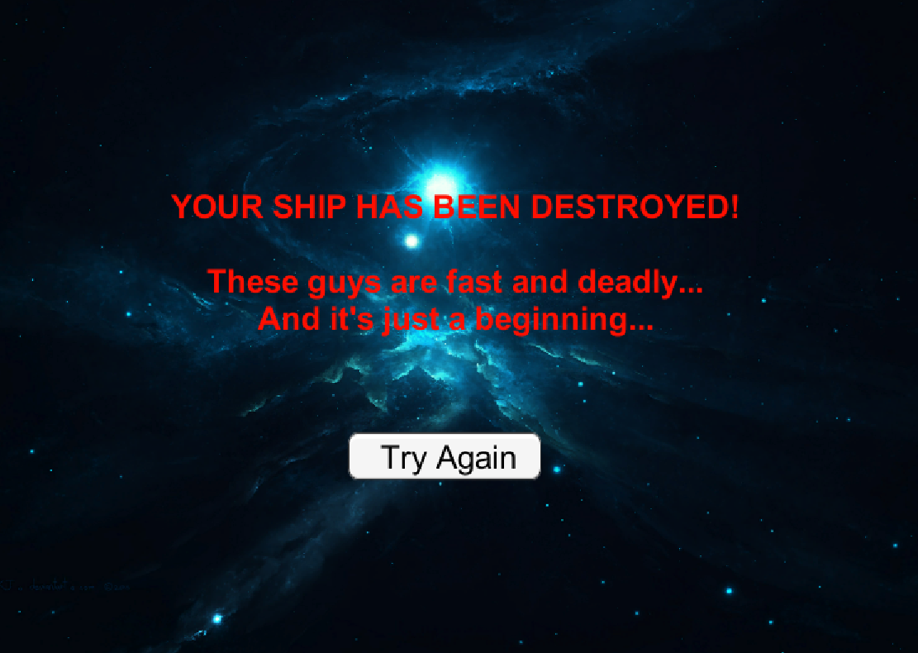
DEATH page

Slide 11
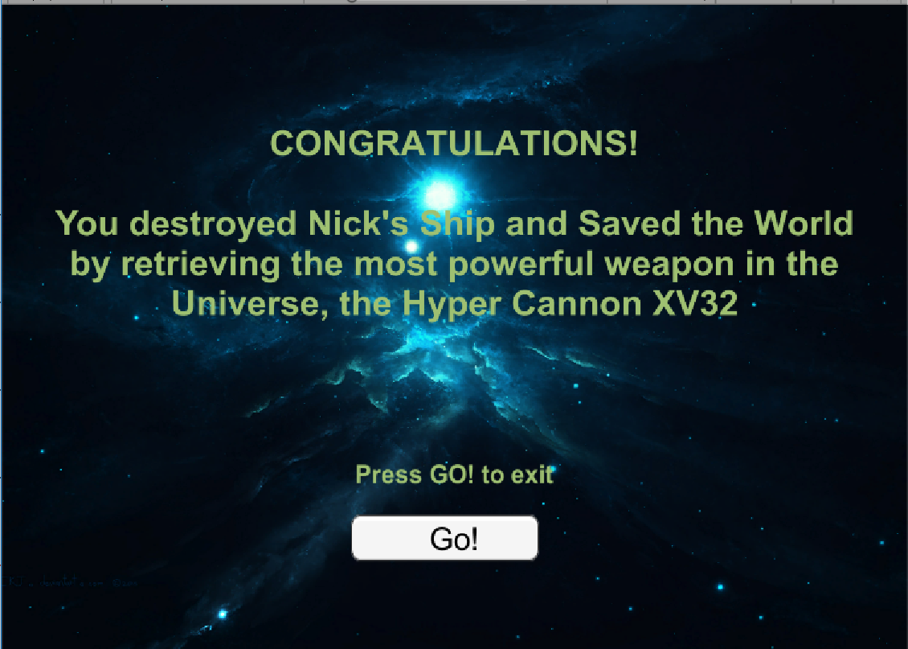
WIN page

Slide 12
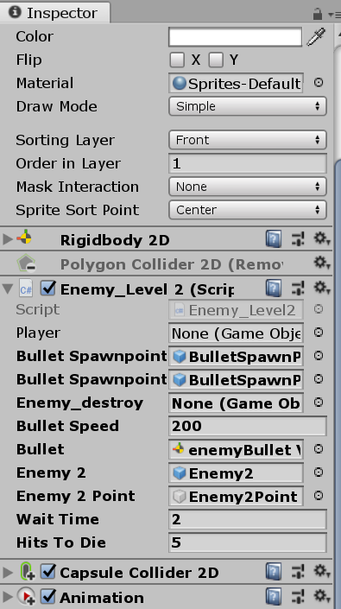
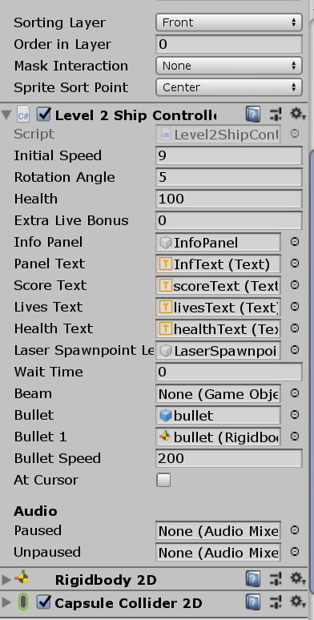
Complexity adjustments

Slide 13
Discoveries Challenges
Work on the levels of objects
Work on the levels of entire components
Building game with no coding
Quaternions
Mouse facing
Specific sound tracks control
Animation

Slide 14
How game could be modified
Replace mouse control with arrows
Adding gamepad control functionality
Implementation of camera following ship to extend game world
Adding animated background
Adding blaster beams in shooting

Slide 15
QUESTIONS?

Slide 16
THANK YOU !

